Slide 1
The Offshore World According to FATCA Niels Johannesen (University of Copenhagen) Daniel Reck (University of Maryland) Max Risch (Carnegie Mellon University) Joel Slemrod (University of Michigan) John Guyton (Internal Revenue Service) Patrick Langetieg (Internal Revenue Service) AEA, Jan 2023
Disclaimer: All findings, opinions, and errors are those of the authors alone and do not necessarily represent the opinions of the Internal Revenue Service or Treasury Department.

Slide 2
Introduction
Globally, households hold an estimated $7 trillion in offshore accounts (Zucman, 2013):
Loss of tax revenue: offshore assets are largely untaxed
Regressivity: offshore assets are highly concentrated among the very wealthiest (e.g. Alstadsæter et al, 2019, Guyton et al 2021)
Policy innovation: FATCA requires all foreign banks to report U.S.-owned accounts to the IRS
Extends third-party information reporting to foreign financial income and assets

Slide 3
This Project
U.S. administrative data: FATCA forms, income tax returns, business-owner links (K-1 information reports)
Questions:
1) What do FATCA reports reveal about offshore holdings?
2) Does automatic third-party reporting on foreign accounts
induce tax compliance?
Today, descriptive analyses from the micro data
Aggregate asset reporting: amount, where and how they are held (households or entities)
Who holds the assets: where in the income distribution
Causal analysis of the effect of FATCA on tax compliance is in progress.

Slide 4
FATCA Reporting Regime
Foreign financial institutions (FFIs) are required to:
Identify accounts ”"beneficially owned” by U.S. taxpayers
(thorough background check searching for U.S. indicia)
Convey information about assets and income to the IRS
Some exceptions (ex. reporting threshold of $50K in assets)
Key differences to previous enforcement initiatives:
Beneficial (rather than immediate) ownership
Automatic (rather than on-request) information exchange
Non-cooperating foreign banks are subject to 30% witholding on U.S. source income

Slide 5
Reporting of Offshore Wealth

Slide 6
Overview: Totals from FATCA Reports
 | TY 2016 | TY 2017 | TY 2018
Assets (billion USD) | 3,648 | 3,233 | 3,981
No. reporting FFIs | 36,056 | 41,829 | 45,308
No. of accounts | 3,703,159 | 4,225,689 | 4,566,774
No. of identified U.S. owners | 1,223,115 | 1,296,462 | 1,477,183
No. accounts w/out identified owners¹ | 1,318,291 | 1,594,459 | 1,664,587
¹ See TIGTA (2018)

Slide 7
FATCA Reports by Owner Type (2018)
 | Account Balance |  | No. of accounts
 | Total (Billions USD) | Share | Total | Share
Partnership | 1,291.64 | 32.4 % | 55,548 | 1.2 %
Individual | 618.49 | 15.5 % | 2,401,217 | 55.7 %
C Corp | 400.64 | 10.0 % | 18,206 | .4 %
Tax exempt entity | 48.59 | 1.2 % | 8,777 | .2 %
Trust | 47.27 | 1.1 % | 9,198 | .2 %
Foreign corporation | 20.64 | .5 % | 6,304 | .1 %
S corporation | 37.18 | .9 % | 8,041 | .1 %
Missing TIN | 1,017.58 | 25.5 % | 1,578,472 | 36.6 %
Unmatched entity | 278.78 | 7.0 % | 12,306 | .2 %
Ambiguous match | 153.74 | 3.8 % | 6,663 | .1 %
Unmatched TIN | 60.01 | 1.5 % | 62,376 | 1.4 %
Unmatched individual | 7.21 | .1 % | 143,141 | 3.3 %

Slide 8
FATCA Reports by Location of Accounts (2018)
 | Havens* | Non-havens | Share in Havens
Wealth (billion USD) | 1,940 | 2,041 | 49%
Accounts | 612,406 | 3,954,216 | 13%
* “Havens” is used as a shorthand descriptor of a set of countries that are low tax jurisdictions and serve as financial centers, as is commonly used in the literature
The IRS does not have any official designation of haven v. non-haven countries and there is no such definition in FATCA law or administration. In line with previous literature, we use the list from Johannesen et al. (2020), which is the OECD (2000) list plus, Switzerland, Singapore, Hong Kong, and Luxembourg.
Future work should refine the countries and institutions that potentially facilitate offshore tax evasion post-FATCA

Slide 9
Reported accounts and wealth by owner type and location (2018)

Slide 10
Comparisons to Previous Literature
Larger wealth in tax havens than suggested by prior US estimates
Our data: $1.94 trillion/10% of GDP in tax havens in 2018
Alstadsæter et al. (2018): $1.1 trillion in havens/7% of GDP in havens in 2007.
Comparable rates of ownership of offshore wealth at the top to Scandinavian data
Our data: 62% of those in top 0.01% own foriegn assets, 57% own haven assets
c.f. 60% of 0.01% of wealth distribution in Scandanavia (Alstadsæter et al. 2019))
Other data from leaks/amnesties: dispropotionately number of top-income recipients, but smaller shares of top-income/wealth individuals appearing in data
Ownership of offshore wealth via partnerships modestly more concentrated than all partnership income
46% of reported offshore partnership assets held by top 0.01%, 80% by the top 1%
c.f. 69% of total partnership income received by top 1% (Cooper et al 2016))

Slide 11
What Can We Learn About Rates of Return? (2018)
Challenges in estimating (nominal taxable) rates of return in offshore accounts:
Missing income information for 45% of accounts/41% of wealth
Some items are not net taxable income amounts (e.g. “gross proceeds”)
We estimate “qausi-” rates of return, e.g. $\frac{Total Int+Div}{Total Acct Bal |Non−Missing Int or Div }$

Slide 12
Partnership account owners and their shareholders
Partnerships hold the plurality of offshore assets, 78% of which are in havens. Using the micro data, we can learn about taxable owners
Link partnership account owners to the entity income tax return (Form 1065) for partnership information
Link shareholders to the partnership
Distribute foreign assets and income to the shareholders (based on their share of total income distributed on K-1s)
Look through levels of pass-through ownership to ultimate taxpayer (Cooper et al. 2016)

Slide 13
Shares of partnership assets by industry and location (2018)
(NAICS 52,53,55)
(NAICS 5239)
Compare to partnership income from all partnerships in 2011 (Cooper et al 2016):
70% Finance, 11% professional services

Slide 14
Shares of Partnership foreign assets by beneficial taxable owner type (2018)
Compare assigned share of partnership foreign assets (red bars) to shares of all partnership income from in 2011 (blue bars, Cooper et al 2016): 20% unclassifiable, 43% individual, 5% tax exempt, 9% foreign, 7% trust, 10% corp

Slide 15
Beneficial individual owners of foreign assets across the income distribution

Slide 16
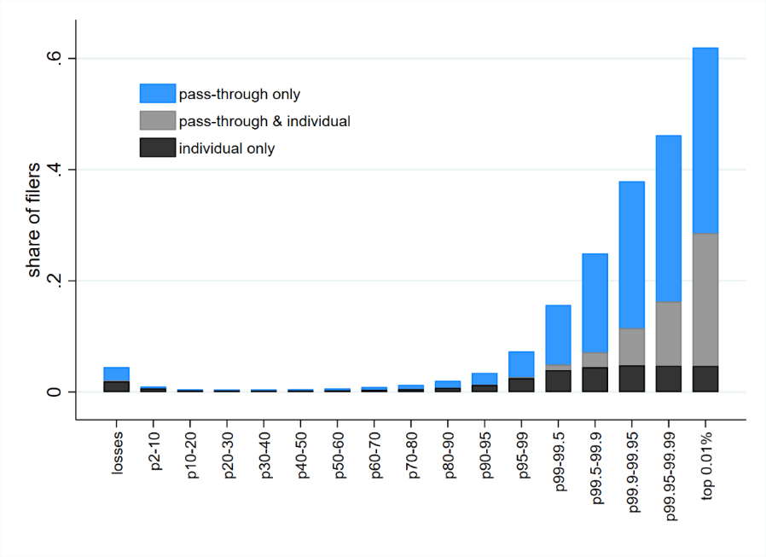
Share of taxpayers with a foreign account by position in the income (AGI) distribution (2018)
Top 1%

Slide 17
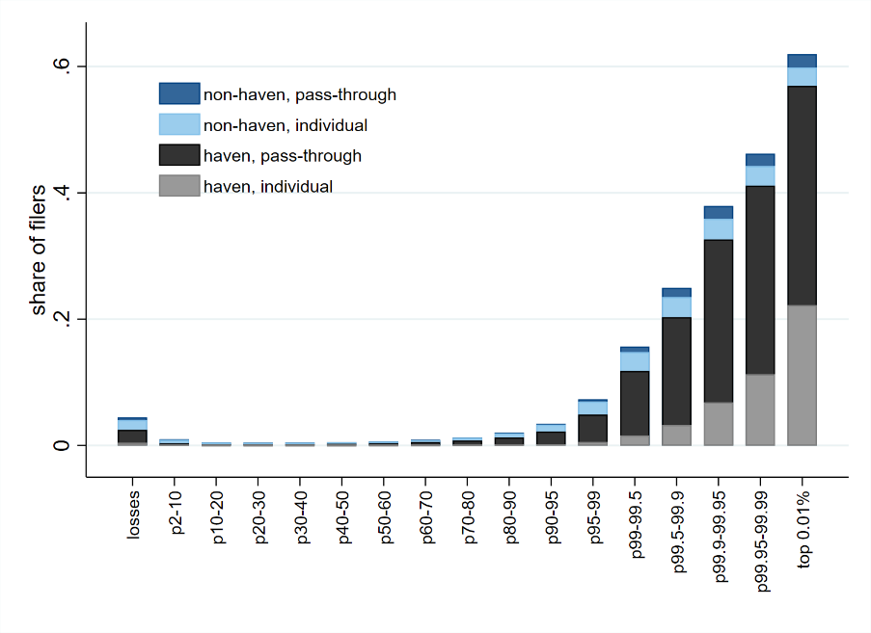
Share of taxpayers with a foreign account by position in the income, haven v non (2018)
Top 1%

Slide 18
Comparisons to Previous Literature
Larger wealth in tax havens than suggested by prior US estimates
Our data: $1.94 trillion/10% of GDP in tax havens in 2018
Alstadsæter et al. (2018): $1.1 trillion in havens/7% of GDP in havens in 2007.
Comparable rates of ownership of offshore wealth at the top to Scandinavian data
Our data: 62% of those in top 0.01% own foriegn assets, 57% own haven assets
c.f. 60% of 0.01% of wealth distribution in Scandanavia (Alstadsæter et al. 2019))
Other data from leaks/amnesties: dispropotionately number of top-income recipients, but smaller shares of top-income/wealth individuals appearing in data
Ownership of offshore wealth via partnerships modestly more concentrated than all partnership income
46% of reported offshore partnership assets held by top 0.01%, 80% by the top 1%
c.f. 69% of total partnership income received by top 1% (Cooper et al 2016))

Slide 19
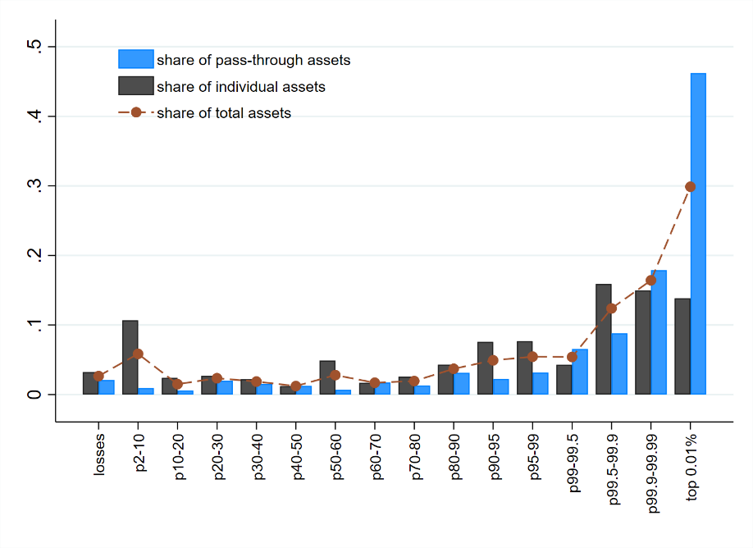
Distribution of assets held directly and held through pass-throughs (2018)
Top 1%

Slide 20
Comparisons to Previous Literature
Larger wealth in tax havens than suggested by prior US estimates
Our data: $1.94 trillion/10% of GDP in tax havens in 2018
Alstadsæter et al. (2018): $1.1 trillion in havens/7% of GDP in havens in 2007.
Comparable rates of ownership of offshore wealth at the top to Scandinavian data
Our data: 62% of those in top 0.01% own foriegn assets, 57% own haven assets
c.f. 60% of 0.01% of wealth distribution in Scandanavia (Alstadsæter et al. 2019))
Other data from leaks/amnesties: dispropotionately number of top-income recipients, but smaller shares of top-income/wealth individuals appearing in data
Ownership of offshore wealth via partnerships modestly more concentrated than all partnership income
46% of reported offshore partnership assets held by top 0.01%, 80% by the top 1%
c.f. 69% of total partnership income received by top 1% (Cooper et al 2016))

Slide 21
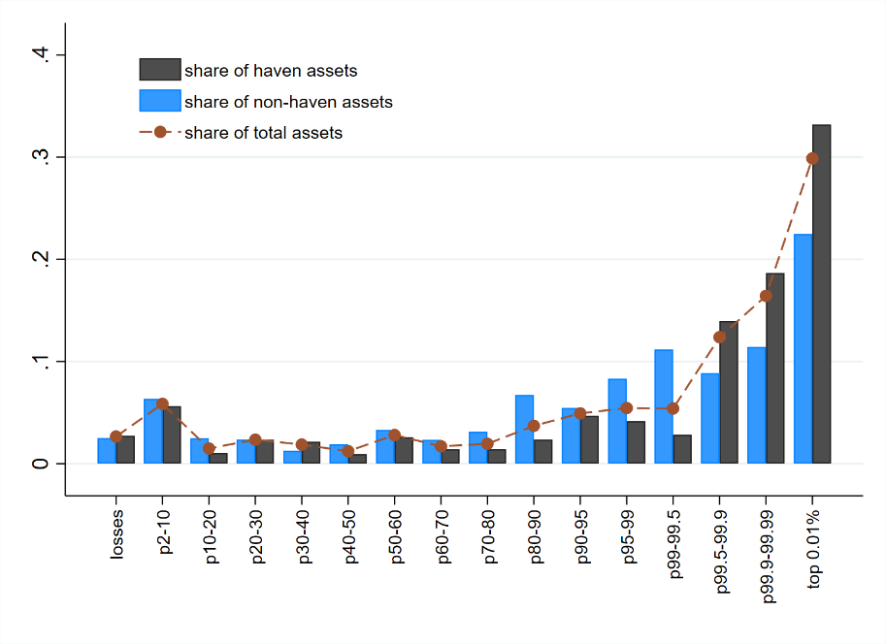
Distribution of assets held in havens and held in non-havens (2018)
Top 1%

Slide 22
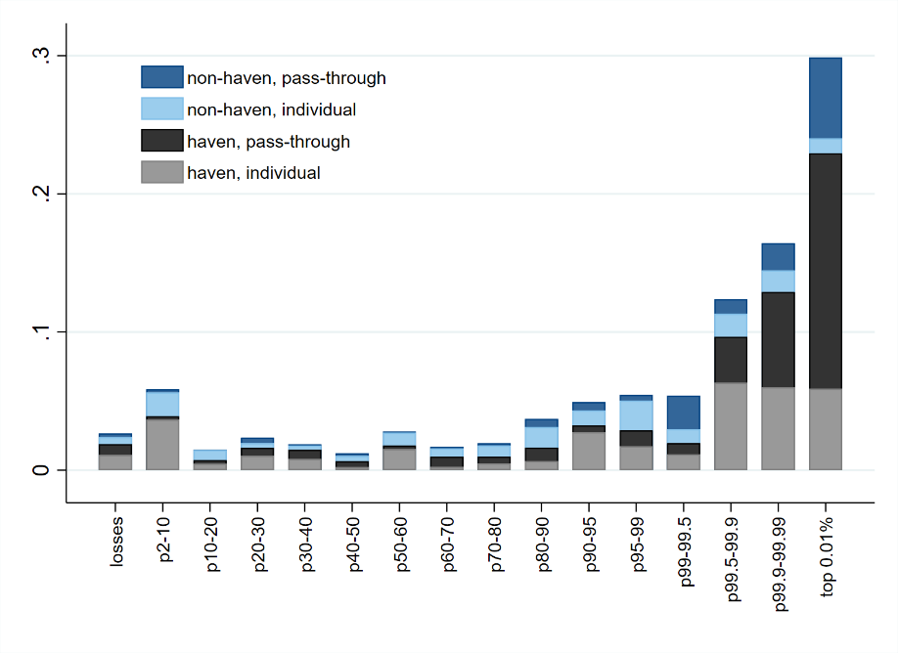
Distribution of total assets (2018)
Top 1%

Slide 23
Comparisons: Concentration of Offshore Wealth
All non-US data rank by wealth; US data rank by income (AGI)
Sources: Johannesen et al 2020 (USA pre-FATCA), Alstadsæter et al 2019 (Nordic), Londoño-Velez & Ávila-Mahecha 2020 (Colombia), Leenders et al 2020 (Netherlands)

Slide 24
Takeaways + Next Steps

Slide 25
Takeaways
FATCA reports provide new micro evidence on offshore holdings
$3.98 trillion of financial wealth.
$1.94 trillion in tax havens (49%), larger than previous estimates
A large share of offshore wealth is held indirectly through entities (at least 46%), particularly partnerships (at least $1.3 trillion, 32%))
Implication: Effects of tax or enforcement policy depend largely on how they affect these entities and how they respond
FATCA accounts, and especially offshore wealth, are highly concentrated
62% of households in the top 0.01% of the income distribution have an account identified by FATCA reports
64% of foreign assets are owned by the top 1% and 30% by the top 0.01%
77% of top 0.01% for. assets held through pass-throughs (61% of top 1%)
77% of top 0.01% foreign assets held in havens (74% of top 1%)
Implication: Tax or enforcement policy disproportionately affect assets held by extremely high-income taxpayers

Slide 26
Further Research/Work In Progress
Find scope for a substantial compliance response ($4 trillion held at top of the distribution, mostly in havens and through partnerships)
Open question: To what extent do the income and assets reported through FATCA yield new tax compliance?
Are they tax compliant post-FATCA?
Were they tax compliant pre-FATCA?
Was there an additional compliance effect from those who chose to repatriate?
Challenges: (i) Long lead-up b/w announcemet (2010) and full FFI reporting (2016). (ii) Control group
Cost-Benefit Debate: FATCA has received public criticism for additional compliance costs on foreign banks and Americans abroad (e.g. Taxpayer Advocate, 2016, Oei, 2018).

Slide 27
Appendix

Slide 28
Insights from the literature
Pre-FATCA enforcement caused modest increase in compliance
Increase in reported foreign accounts around U.S. enforcement efforts in 2008-2009 (Johannesen, Langetieg, Reck, Risch and Slemrod, 2020)
Decrease in offshore deposits and the value of offshore banks around leaks of customer data (Johannesen and Stolper, 2017)
…as well as actions by evaders to circumvent enforcement:
More indirect ownership through offshore corporations (Johannesen, 2014; Omartian, 2016)
Relocation of assets to non-cooperating havens (Johannesen and Zucman, 2014)
Indirect evidence that FATCA / CRS boosted tax compliance
Decrease in the use of offshore holding companies around implementation of FATCA (Omartian, 2016)
Drop in foreign-owned assets at activation of automatic information exchange (Menkhoff and Miethe, 2017; Casi et al., 2018; De Simone et al., 2018)

Slide 29
Pre-FATCA enforcement initiatives
Global battle against offshore tax evasion in the past decade:
Legal action against offshore banks
(U.S.: case against UBS starts in July 2008 )
Treaties with tax havens: case-by-case information exchange on request
(U.S.: treaties with Switzerland, Luxembourg, Panama in 2008-2010)
Automatic Exchange of Information (AEOI) agreements with specific set of countries
Temporarily reduced penalties for voluntary disclosers of offshore assets
(U.S.: OVDP starts in March 2009)
Whistleblowers in offshore banks and tax haven law firms
(U.S.: Brad Birkenfeld’s whistleblowing triggers the case against UBS)

Slide 30
Matched and unmatched owner types (2018)
 | Account Balance |  | No. of accounts
 | Total (Billions USD) | Share | Total | Share
Matched Entity | 1,291.64 | 46.1 % | 55,548 | 2.2 %
Matched Individual | 618.49 | 15.5 % | 2,401,217 | 55.7 %
Missing TIN | 1,017.58 | 25.5 % | 1,578,472 | 36.6 %
Missing, US Entity | 886.31 | 22.2 % | 1,215,727 | 28.2 %
Missing, US Individual | 116.00 | 2.9 % | 350,131 | 8.1 %
Unmatched entity | 278.78 | 7.0 % | 12,306 | .2 %
Ambiguous match | 153.74 | 3.8 % | 6,663 | .1 %
Unmatched TIN | 60.01 | 1.5 % | 62,376 | 1.4 %
Unmatched individual | 7.21 | .1 % | 143,141 | 3.3 %

Slide 31
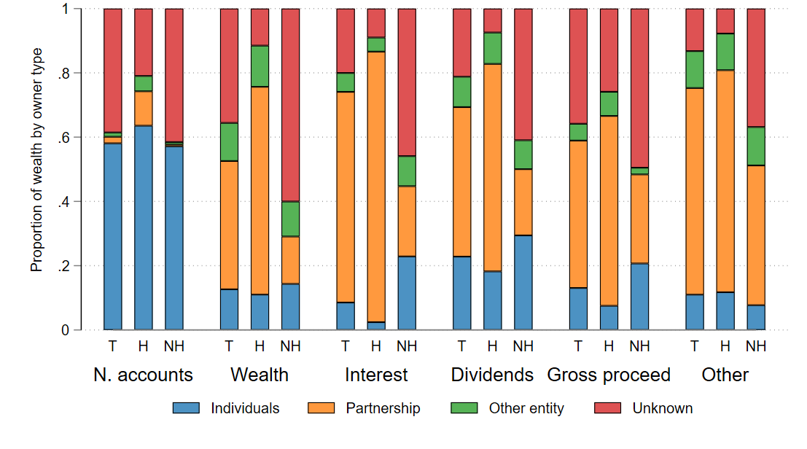
Reported accounts and wealth by owner type and location (2018)
T = total, H= haven, NH = non-haven

Slide 32
(Ad hoc) Robustness to $50K reporting threshold
Hypothetical distribution of foreign assets assuming 10% of households below 90th percentile have $40,000 in foreign assets (i.e. just below the FATCA reporting threshold)
- 42% of assets held by top 1%, relative to observed 64% on FATCA reports (21% by top 0.01% relative to 30%)

